Slide 1
Green Tech

Slide 2
“One man’s trash is another man’s treasure”

Slide 3
What is the problem?
Inappropriate discharge of excess or expired food from various sectors.

Slide 4
Food wastage from various sectors
Restaurants
Leftovers
Cooking residues
Factories
Raw Materials
Food wasted due to any inefficiency in production
Supermarkets
Unsold Veggies and Fruits
Expired/ About to expire food

Slide 5


Goal
Collection and Management of Waste Food through our Website

Slide 6
Our Website
Producer
Consumer
Fill in the details and if we are functioning in your region, our team will contact you.
Select from the provided categories on the website according to your needs and proceed

Slide 7
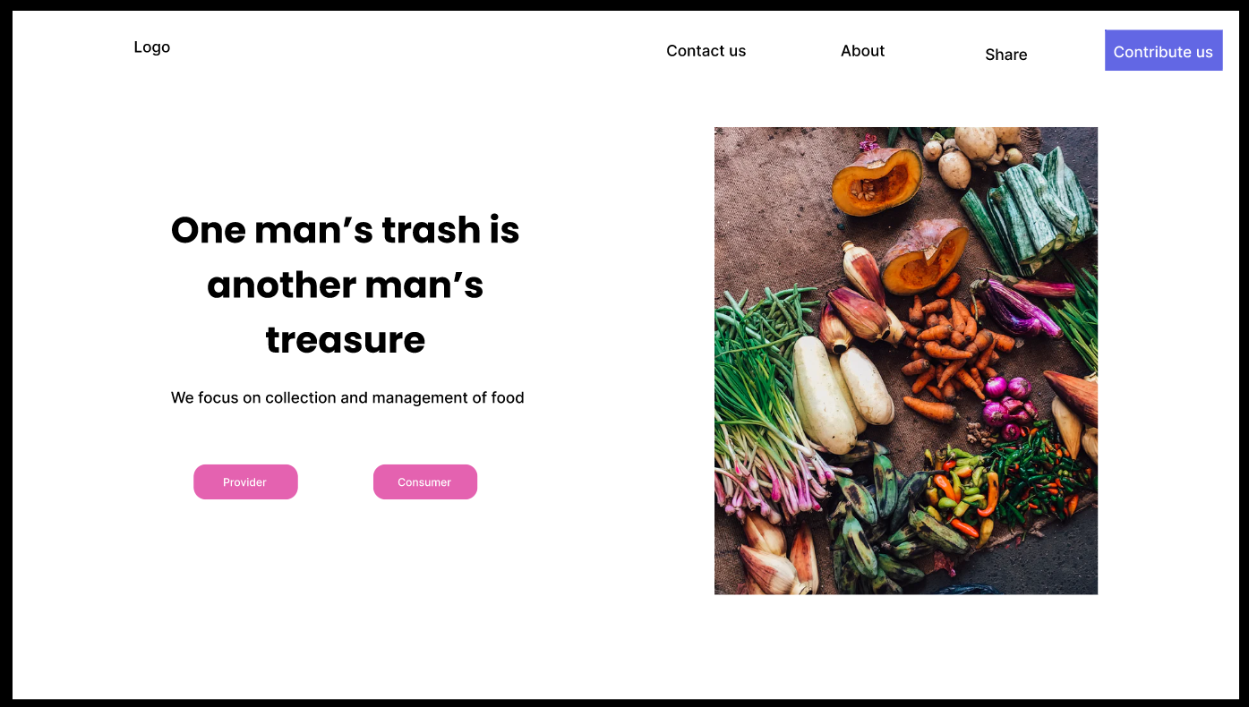

Slide 8
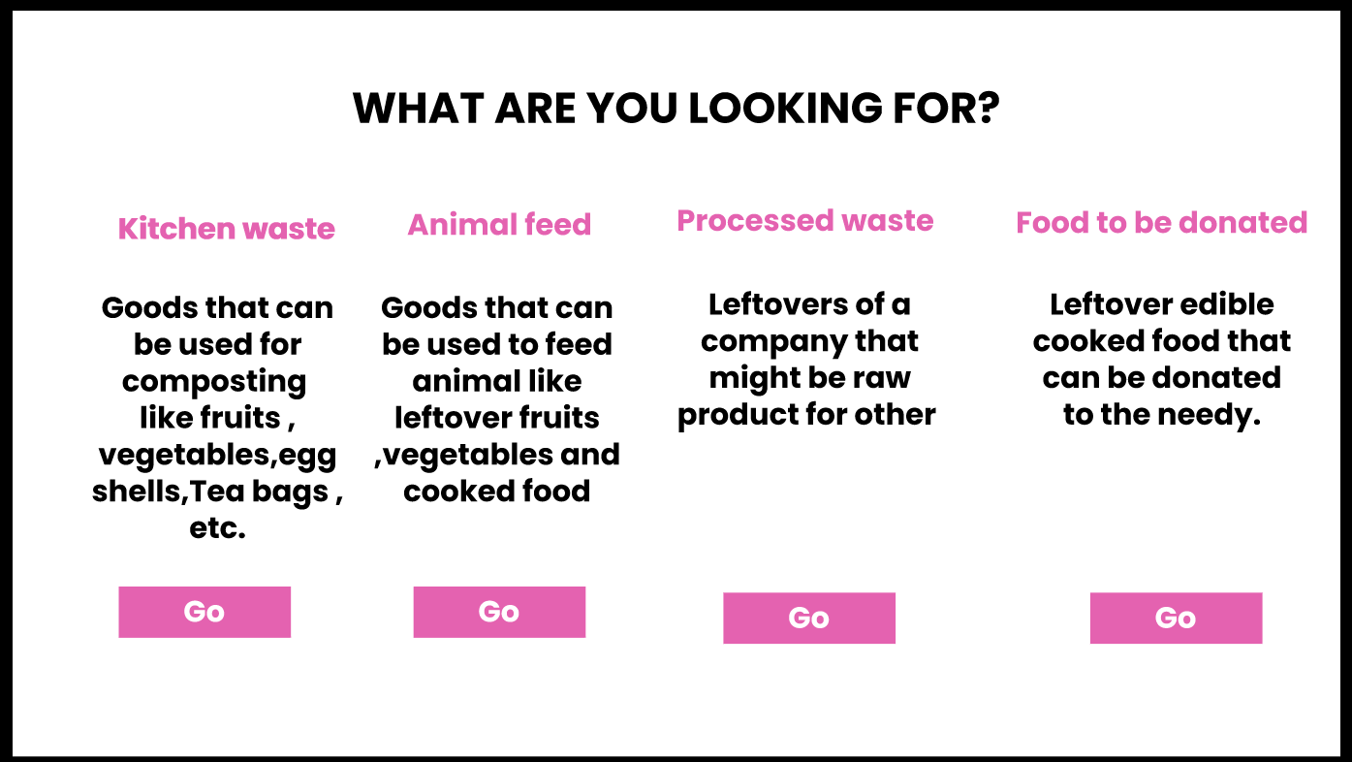

Slide 9


Slide 10


Slide 11
LINK TO OUR DEMO WEBSITE:
https://www.figma.com/file/blBW23kPpJPpqmmJwNcKuV/Untitled?node-id=0%3A1

Slide 12
Benefits
Climate Change Migration
Economical Benefits
Food waste diversion
Reduces the production of greenhouse gases which are emitted from the dumping areas.
If you are wasting less, you are spending less. Waste costs money no matter how you look at it.
Reusing, recycling, or composting materials that would otherwise be buried in the landfill
1
2
3

Slide 13
Team Members:
Mohd. Sahil
Dewang Shishodia
Rachna Bharti
Tanish Nagar
Team: HACK12

Slide 14
Thanks!

